Slide 1
Global RANS solver – MATLAB code
Matteo Puccioni and G. Valerio Iungo
Wind Fluids and Experiments (WindFluX) Laboratory, Mechanical Engineering Department, The University of Texas at Dallas, 800 W Campbell Rd, 75080 Richardson, Texas, USA

Slide 2
Introduction
Theoretical background
Numerical features
Main script:
Pre-processing
Numerical RANS solver
Post processing

Slide 3
Theoretical background

Slide 4
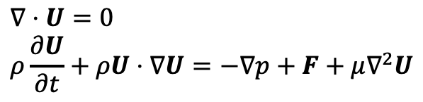
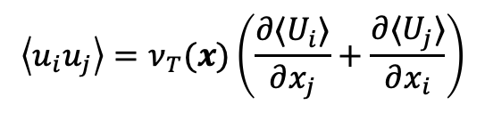
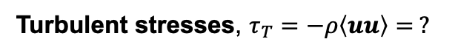
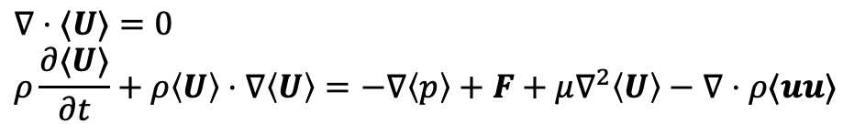
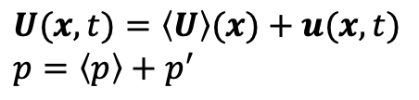
Theoretical background
Navier-Stokes (NS) equations for incompressible flow:
$$∇⋅U=0 \\ ρ\frac{∂U}{∂t}+ρU⋅∇U=−∇p+F+μ∇^{2}U$$
Ensemble average of each physical quantity:
$$U(x,t)=\left\langle U\right\rangle (x)+u(x,t) \\ p=\left\langle p\right\rangle +p^{′}$$
Ensemble average of the NS equations (Reynolds Averaged Navier Stokes equations, RANS):
$$∇⋅⟨U⟩=0 \\ ρ\frac{∂⟨U⟩}{∂t}+ρ\left\langle U\right\rangle ⋅∇\left\langle U\right\rangle =−∇\left\langle p\right\rangle +F+μ∇^{2}\left\langle U\right\rangle −∇⋅ρ⟨uu⟩$$
Turbulent stresses, $τ_{T}=−ρ\left\langle uu\right\rangle = ?$
With RANS equations, all the turbulent scales must be modeled instead of being resolved
Boussinesq hypothesis ([1]):
$$\left\langle u_{i}u_{j}\right\rangle =ν_{T}(x)\left(\frac{∂⟨U_{i}⟩}{∂x_{j}}+\frac{∂⟨U_{j}⟩}{∂x_{i}}\right)$$
Eddy viscosity

Slide 5
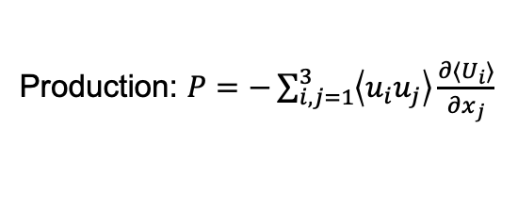
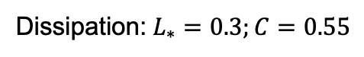
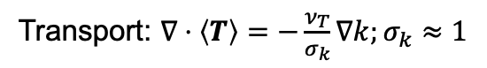
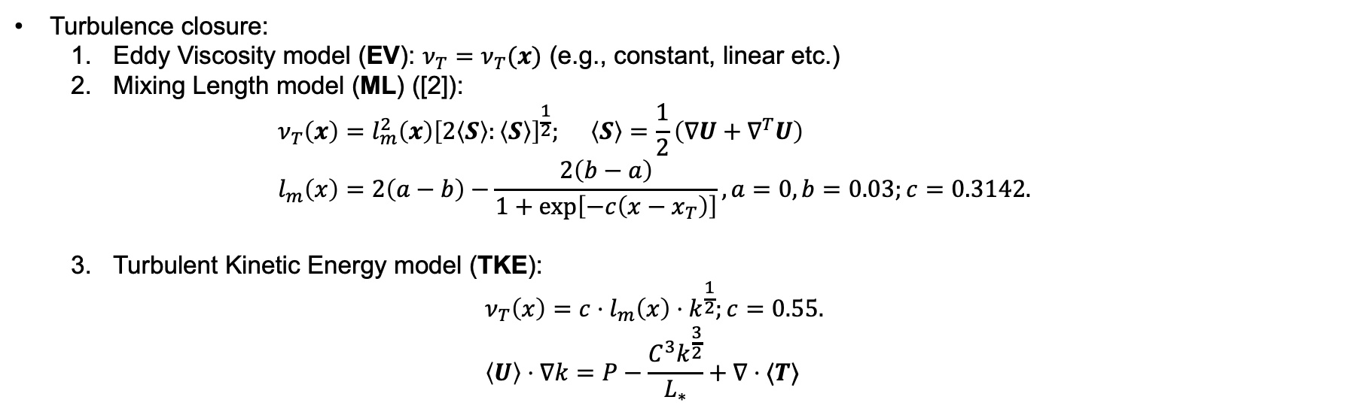
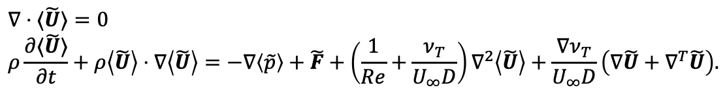
Theoretical background
Non-dimensional RANS equations ($\tilde{U}=U/U_{∞}$; $\tilde{p}=p/ρU_{∞}^{2}$)
$$∇⋅⟨\tilde{U}⟩=0 \\ ρ\frac{∂⟨\tilde{U}⟩}{∂t}+ρ\left\langle \tilde{U}\right\rangle ⋅∇\left\langle \tilde{U}\right\rangle =−∇\left\langle \tilde{p}\right\rangle +\tilde{F}+\left(\frac{1}{Re}+\frac{ν_{T}}{U_{∞}D}\right)∇^{2}\left\langle \tilde{U}\right\rangle +\frac{∇ν_{T}}{U_{∞}D}\left(∇\tilde{U}+∇^{T}\tilde{U}\right).$$
Turbulence closure:
Eddy Viscosity model (EV): $ν_{T}=ν_{T}(x)$ (e.g., constant, linear etc.)
Mixing Length model (ML) ([2]):
$$ν_{T}\left(x\right)=l_{m}^{2}\left(x\right){\left[2\left\langle S\right\rangle :\left\langle S\right\rangle \right]}^{\frac{1}{2}}; \left\langle S\right\rangle =\frac{1}{2}\left(∇U+∇^{T}U\right) \\ l_{m}\left(x\right)=2\left(a−b\right)−\frac{2\left(b−a\right)}{1+\exp\left[−c\left(x−x_{T}\right)\right]}, a=0, b=0.03;c=0.3142.$$
Turbulent Kinetic Energy model (TKE):
$$ν_{T}\left(x\right)=c⋅l_{m}\left(x\right)⋅k^{\frac{1}{2}};c=0.55. \\ \left\langle U\right\rangle ⋅∇k=P−\frac{C^{3}k^{\frac{3}{2}}}{L_{∗}}+∇⋅⟨T⟩$$
Algebraic model
One equation model
Transport: $∇⋅\left\langle T\right\rangle =−\frac{ν_{T}}{σ_{k}}∇k;σ_{k}≈1$
Dissipation: $L_{∗}=0.3;C=0.55$
Production: $P=−\sum_{i,j=1}^{3}{\left\langle u_{i}u_{j}\right\rangle \frac{∂⟨U_{i}⟩}{∂x_{j}}}$

Slide 6
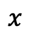
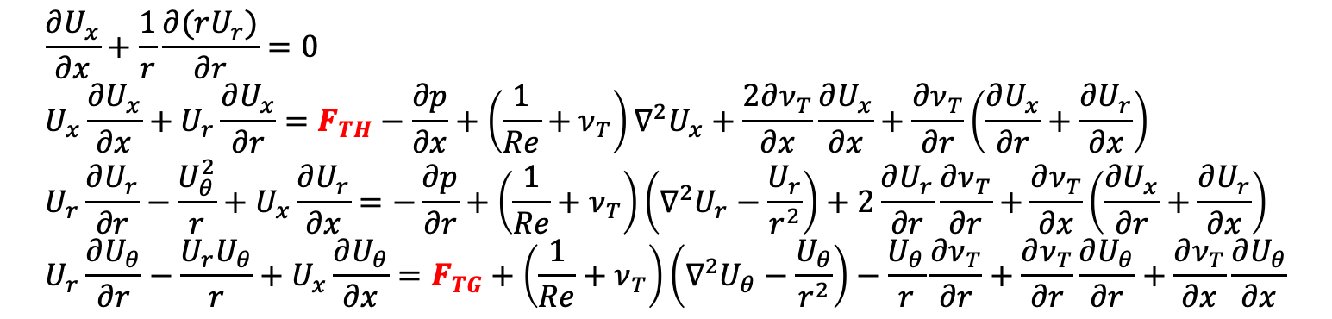
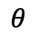
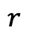
Theoretical background
Cylindrical coordinate system $\left(r,θ,x\right);$
Axisymmetric, 3D incompressible flow:
$$θ$$
$$x$$
$$\frac{∂U_{x}}{∂x}+\frac{1}{r}\frac{∂(rU_{r})}{∂r}=0 \\ U_{x}\frac{∂U_{x}}{∂x}+U_{r}\frac{∂U_{x}}{∂r}=F_{TH}−\frac{∂p}{∂x}+\left(\frac{1}{Re}+ν_{T}\right)∇^{2}U_{x}+\frac{2∂ν_{T}}{∂x}\frac{∂U_{x}}{∂x}+\frac{∂ν_{T}}{∂r}\left(\frac{∂U_{x}}{∂r}+\frac{∂U_{r}}{∂x}\right) \\ U_{r}\frac{∂U_{r}}{∂r}−\frac{U_{θ}^{2}}{r}+U_{x}\frac{∂U_{r}}{∂x}=−\frac{∂p}{∂r}+\left(\frac{1}{Re}+ν_{T}\right)\left({∇^{2}U}_{r}−\frac{U_{r}}{r^{2}}\right)+2\frac{∂U_{r}}{∂r}\frac{∂ν_{T}}{∂r}+\frac{∂ν_{T}}{∂x}\left(\frac{∂U_{x}}{∂r}+\frac{∂U_{r}}{∂x}\right) \\ U_{r}\frac{∂U_{θ}}{∂r}−\frac{U_{r}U_{θ}}{r}+U_{x}\frac{∂U_{θ}}{∂x}=F_{TG}+\left(\frac{1}{Re}+ν_{T}\right)\left(∇^{2}U_{θ}−\frac{U_{θ}}{r^{2}}\right)−\frac{U_{θ}}{r}\frac{∂ν_{T}}{∂r}+\frac{∂ν_{T}}{∂r}\frac{∂U_{θ}}{∂r}+\frac{∂ν_{T}}{∂x}\frac{∂U_{θ}}{∂x}$$
$$r$$
From [3]
The terms $F_{TH}$ and $F_{TG}$ represent the thrust and the tangential force exerted by the turbine on the mean flow.

Slide 7
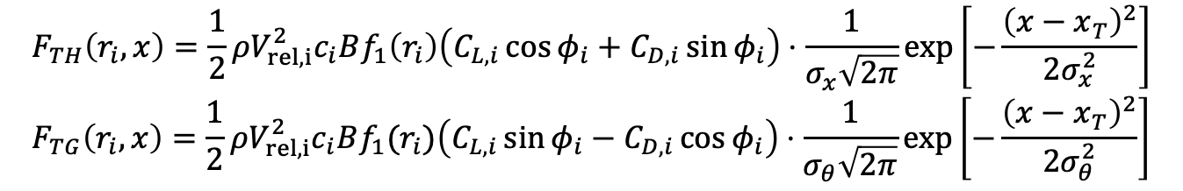
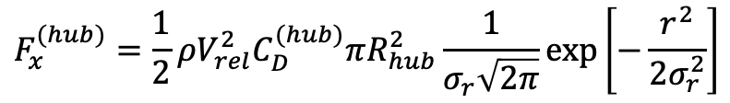
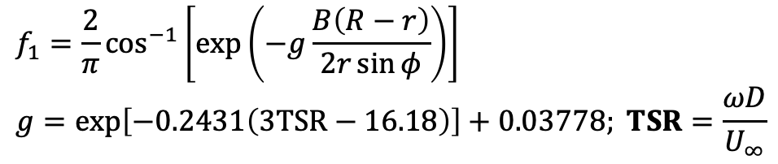
Theoretical background
Actuator Disk Model (ADM) [3]:
$$F_{TH}\left(r_{i},x\right)=\frac{1}{2}ρV_{rel, i}^{2}c_{i}Bf_{1}\left(r_{i}\right)\left(C_{L,i}\cos{φ_{i}}+C_{D,i}\sin{φ_{i}}\right)⋅\frac{1}{σ_{x}\sqrt{2π}}\exp\left[−\frac{{\left(x−x_{T}\right)}^{2}}{2σ_{x}^{2}}\right] \\ F_{TG}\left(r_{i},x\right)=\frac{1}{2}ρV_{rel, i}^{2}c_{i}Bf_{1}(r_{i})\left(C_{L,i}\sin{φ_{i}}−C_{D,i}\cos{φ_{i}}\right)⋅\frac{1}{σ_{θ}\sqrt{2π}}\exp\left[−\frac{{\left(x−x_{T}\right)}^{2}}{2σ_{θ}^{2}}\right]$$
Relative velocity
Gaussian spreading functions
Lift/drag coefficients (NREL 5MW wind turbine)
Chord length
From [3]
Number of blades
Hub axial forcing:
$$F_{x}^{(hub)}=\frac{1}{2}ρV_{rel}^{2}C_{D}^{(hub)}πR_{hub}^{2}\frac{1}{σ_{r}\sqrt{2π}}\exp\left[−\frac{r^{2}}{2σ_{r}^{2}}\right]$$
Tip correction [4]
$$f_{1}=\frac{2}{π}\cos^{−1}\left[\exp\left(−g\frac{B\left(R−r\right)}{2r\sin{φ}}\right)\right] \\ g=\exp\left[−0.2431\left(3TSR−16.18\right)\right]+0.03778; TSR=\frac{ωD}{U_{∞}}$$

Slide 8
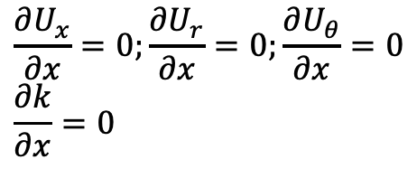
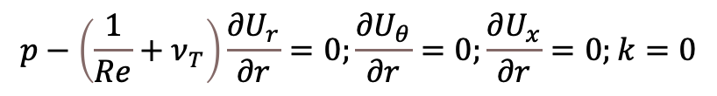
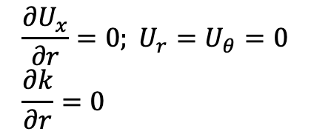
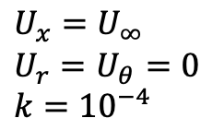
Theoretical background
Boundary conditions:
$$p−\left(\frac{1}{Re}+ν_{T}\right)\frac{∂U_{r}}{∂r}=0;\frac{∂U_{θ}}{∂r}=0;\frac{∂U_{x}}{∂r}=0;k=0$$
Incoming flow
$$U_{x}=U_{∞} \\ U_{r}=U_{θ}=0 \\ k={10}^{−4}$$
$$\frac{∂U_{x}}{∂x}=0;\frac{∂U_{r}}{∂x}=0;\frac{∂U_{θ}}{∂x}=0 \\ \frac{∂k}{∂x}=0$$
$$\frac{{∂U}_{x}}{∂r}=0; U_{r}=U_{θ}=0 \\ \frac{∂k}{∂r}=0$$

Slide 9
Numerical features

Slide 10
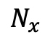
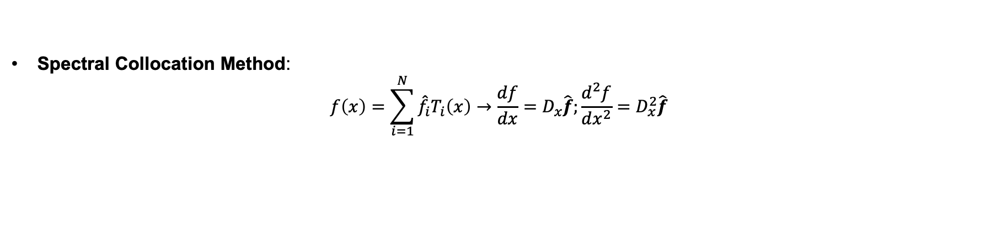
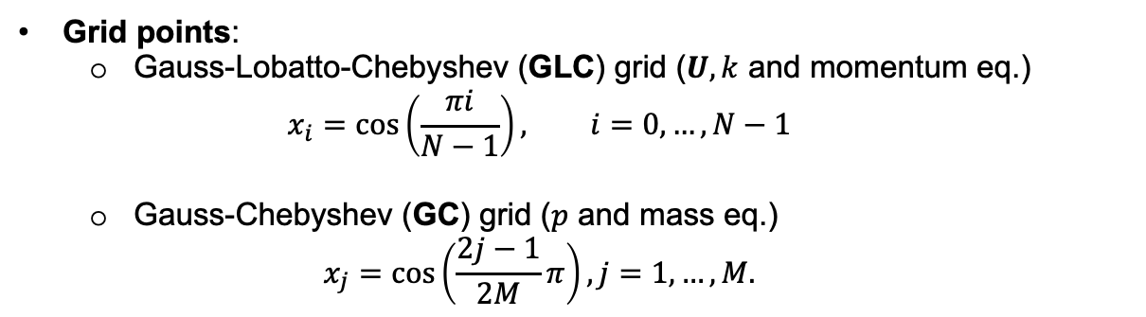
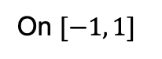
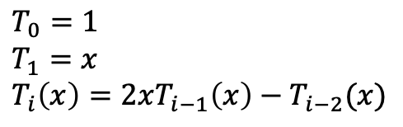
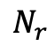
Numerical features
Spectral Collocation Method:
$$f\left(x\right)=\sum_{i=1}^{N}{{\hat{f}}_{i}T_{i}\left(x\right)}→\frac{df}{dx}=D_{x}\hat{f};\frac{d^{2}f}{dx^{2}}=D_{x}^{2}\hat{f}$$
Chebyshev basis functions:
Grid points:
Gauss-Lobatto-Chebyshev (GLC) grid ($U, k$ and momentum eq.)
$$x_{i}=\cos\left(\frac{πi}{N−1}\right), i=0,…,N−1$$
Gauss-Chebyshev (GC) grid ($p$ and mass eq.)
$$x_{j}=\cos\left(\frac{2j−1}{2M}π\right), j=1,…,M.$$
$$T_{0}=1 \\ T_{1}=x \\ T_{i}\left(x\right)=2xT_{i−1}\left(x\right)−T_{i−2}(x)$$
On $[−1, 1]$
$$N_{x}$$
$$N_{r}$$

Slide 11
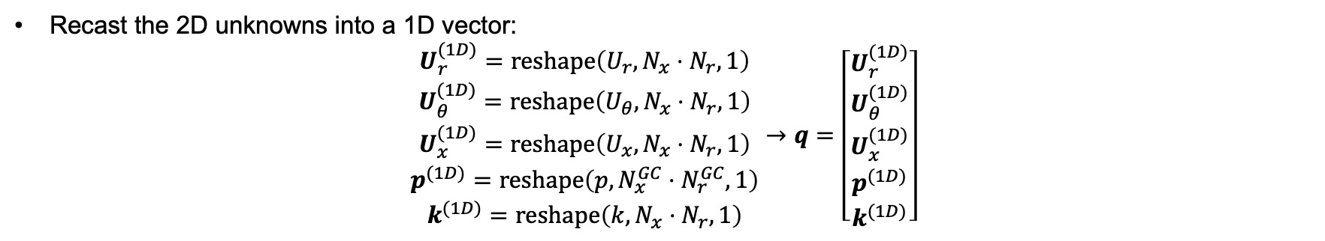
Numerical features
Recast the 2D unknowns into a 1D vector:
$$\begin{matrix}U_{r}^{(1D)}=reshape\left(U_{r},N_{x}⋅N_{r},1\right) \\ U_{θ}^{(1D)}=reshape\left(U_{θ},N_{x}⋅N_{r},1\right) \\ \begin{matrix}U_{x}^{(1D)}=reshape\left(U_{x},N_{x}⋅N_{r},1\right) \\ p^{(1D)}=reshape\left(p,N_{x}^{GC}⋅N_{r}^{GC},1\right) \\ k^{(1D)}=reshape\left(k,N_{x}⋅N_{r},1\right)\end{matrix}\end{matrix}→q=\left[\begin{matrix}U_{r}^{(1D)} \\ U_{θ}^{(1D)} \\ \begin{matrix}U_{x}^{(1D)} \\ p^{(1D)} \\ k^{(1D)}\end{matrix}\end{matrix}\right]$$
Discretization of RANS equations:
$$\frac{∂U_{x}}{∂x}+\frac{1}{r}\frac{∂\left(rU_{r}\right)}{∂r}=0→F_{mass}=D_{x}U_{x}^{(1D)}+\frac{1}{R}D_{r}\left(RU_{r}^{\left(1D\right)}\right)=0$$
$$F_{x}=U_{x}\frac{∂U_{x}}{∂x}+U_{r}\frac{∂U_{x}}{∂r}−F_{TH}+\frac{∂p}{∂x}−\left(\frac{1}{Re}+ν_{T}\right)∇^{2}U_{x}−\frac{2∂ν_{T}}{∂x}\frac{∂U_{x}}{∂x}−\frac{∂ν_{T}}{∂r}\left(\frac{∂U_{x}}{∂r}+\frac{∂U_{r}}{∂x}\right)=0→ \\ F_{x}≈U_{x}^{\left(1D\right)}D_{x}U_{x}^{\left(1D\right)}+U_{r}^{\left(1D\right)}D_{r}U_{x}^{\left(1D\right)}−F_{TH}+D_{x}^{GC}p^{\left(1D\right)}−\left(\frac{1}{Re}+ν_{T}\right)D^{2}U_{x}^{\left(1D\right)}−2\left[D_{x}ν_{T}^{\left(1D\right)}\right]\left[D_{x}U_{x}^{\left(1D\right)}\right]−\left[D_{r}ν_{T}^{\left(1D\right)}\right]\left[D_{x}U_{r}^{\left(1D\right)}+D_{r}U_{x}^{\left(1D\right)}\right]=0$$
Deal with non-linear discretized equations: Newton-Raphson method

Slide 12
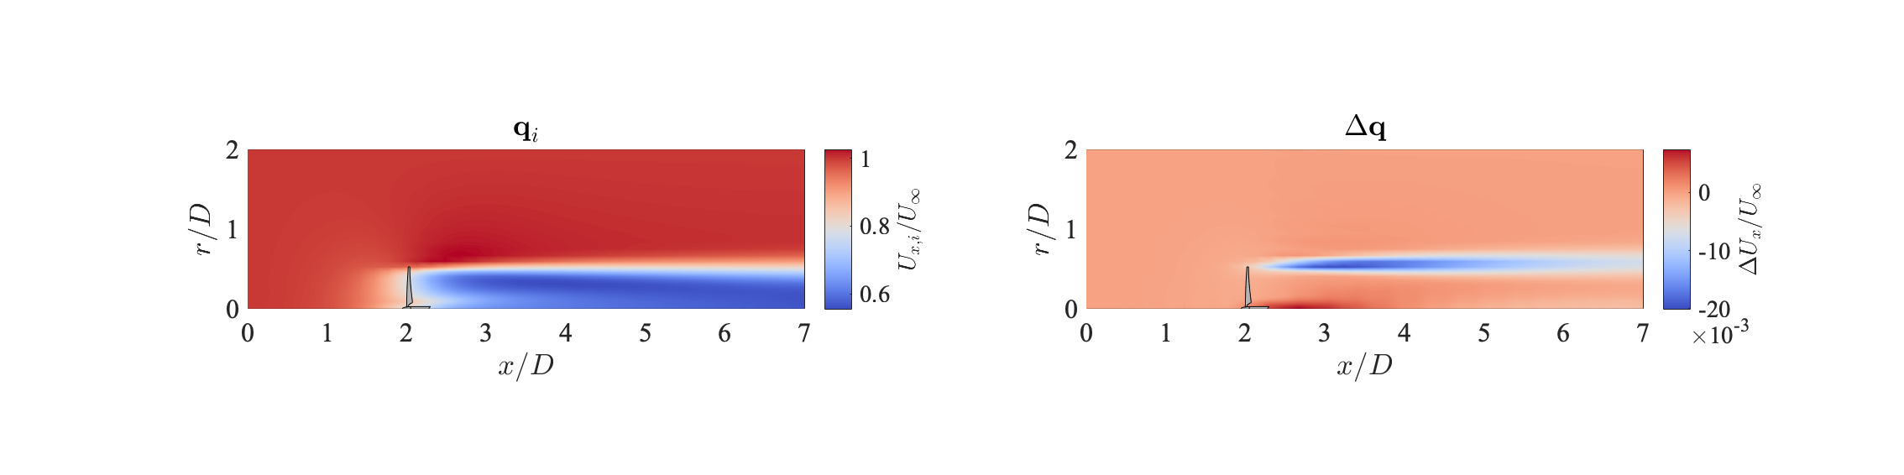
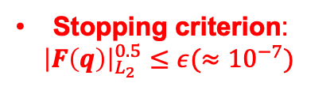
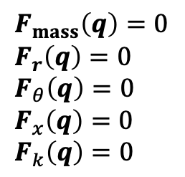
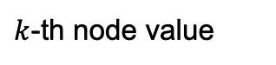
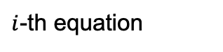
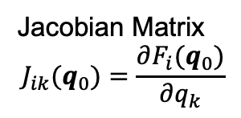
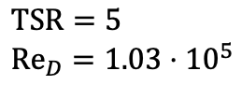
Numerical features
Initial velocity/pressure/TKE field
Residual vector
$$F_{mass}\left(q\right)=0 \\ F_{r}\left(q\right)=0 \\ F_{θ}\left(q\right)=0 \\ F_{x}\left(q\right)=0 \\ F_{k}\left(q\right)=0$$
RANS equations in continuous form
$$F\left(q\right)≈F\left(q_{0}\right)+J\left(q_{0}\right)\left(q_{1}−q_{0}\right)=0→q_{i+1}=q_{i}−J^{−1}\left(q_{i}\right)F(q_{i})$$
Discretization (Spectral Collocation Method)
Jacobian Matrix
$$J_{ik}(q_{0})=\frac{∂F_{i}(q_{0})}{∂q_{k}}$$
$i$-th equation
Stopping criterion:
$${\left|F\left(q\right)\right|}_{L_{2}}^{0.5}≤ε(≈{10}^{−7})$$
$k$-th node value
$$TSR=5 \\ Re_{D}=1.03⋅{10}^{5}$$

Slide 13
MATLAB code

Slide 14
References
[1] Boussinesq, MJ. (1897). Theorie de l’ecoulement tourbillonnant et tumultueux des liquides. Gauthier-Villars et fils, Paris, France.
[2] Iungo G. V., Santhanagopalan V., Ciri U., Viola F., Zhan L., Rotea M. A. and Leonardi S. (2015). Data-driven RANS solver for low-computational cost simulations of wind turbine wakes. Journal of Physics: Conference Series, vol. 625
[3] Porté-Agel, F., Wu, Y. T., Lu, H. and Conzemius, R. J. (2011). Large-eddy simulation of atmospheric boundary layer flow through wind turbines and wind farms. Journal of Wind Engineering and Industrial Aerodynamics, 99(4), 154-168.
[4] Shen, W. Z., Sørensen, J. N., & Mikkelsen, R. (2005). Tip loss correction for actuator/Navier-Stokes computations. Journal of Solar Energy Engineering, Transactions of the ASME, 127(2), 209–213.
Thank you!
Contacts:
Matteo.Puccioni@utdallas.edu
Valerio.Iungo@utdallas.edu

